Slide 1
Project Delta Airlines
By Huss Issa, David Wu Ricardo Benitez, Matt Kenney

Slide 2
Motivation and Summary
Analyzing Deltas volume before and during Covid
Analyzing how Covid has affected Delta’s freight volume
How has Delta’s market position changed since covid
Evaluate how Delta’s Atlanta routes to Los Angeles, New York, and Houston have been affected.
Project Delta’s future volumes
Why? To see how Covid has affected Delta’s position in the Industry for freight and passenger.

Slide 3
Questions & Data
We needed to be able to have passenger and freight data from various major routes to give us an indication of Delta’s volume compared to its competitors
We need to have data from before and after the pandemic
Based on limited data we had since the vaccine was approved, we need to have some data to help project future volumes.
We found our data at: https://transtats.bts.gov/databases.asp?Z1qr_VQ=E&Z1qr_Qr5p=N8vn6v10&f7owrp6_VQF=D

Slide 4
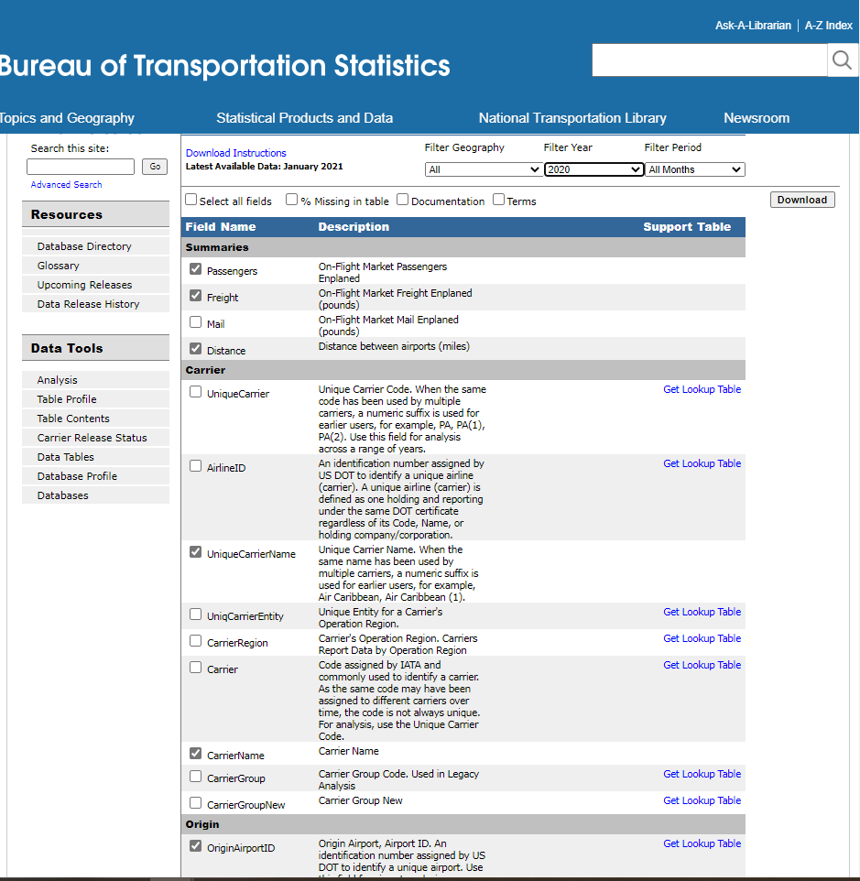
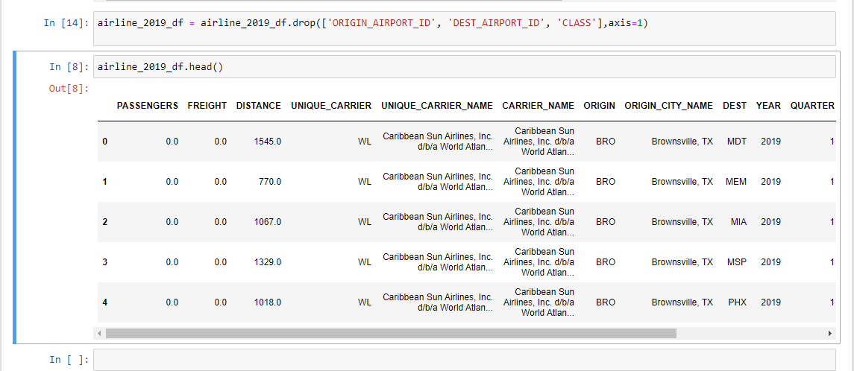
Data Exporation and Cleanup
The Data we acquired was relatively clean because the database was an Airline Database based on government data OST_R | BTS | Transtats
The Data Cleanup process included selecting the relevant columns from the website, and downloading the data, and dropping irrelevant columns in jupyter notebooks

Slide 5
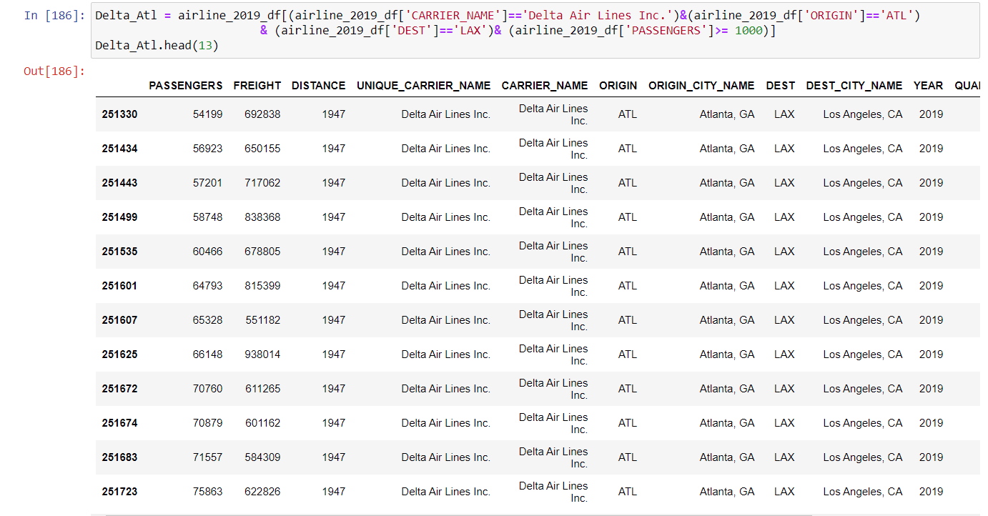
Data Exploration and Cleanup
Afterwards we selected the rows we needed for through Jupyter notebooks.
Then sorted the data by month (numerical 1 to 12)
We did this for both the 2019 and 2020 data so that we could have a comparison.

Slide 6
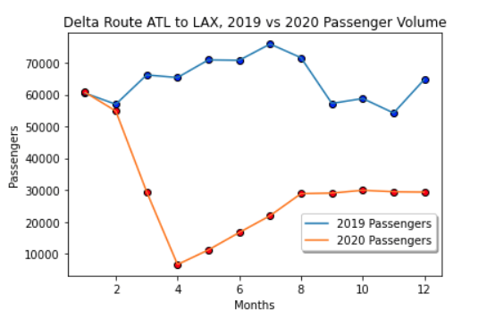
Data Analysis: Sample Atlanta to Los Angeles, Delta Passenger Volume
From what we gather for the comparison aggregated 2019 and 2020 data for Delta Airlines, Atlanta to Los Angeles, for this route in 2019 travel had a higher volume during the summer months.
During March to April of 2020 there was a significant drop off in passengers for this route because of the impact of Covid-19
By August of 2020, passenger travel resumed to a bit less than 50 percent capacity, because of social distancing measures implemented by the company.

Slide 7
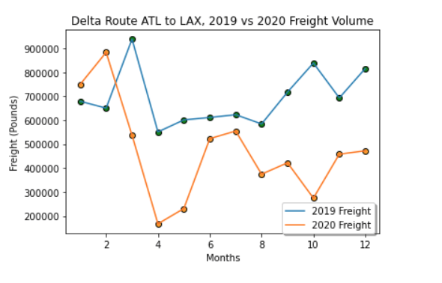
Comparison of Freight Data Atlanta to Los Angeles 2019 to 2020
The Freight data doesn’t appear to be as affected between 2019 and 2020.
During 2020, there was an initial dropoff in volume as airlines were grounded, however during the summer months, volume appeared to temporarily return closer to normal.
For this route, during the higher volume months of October to December, companies comparatively chose not to use as much Delta Air Freight as that of the previous year.

Slide 8
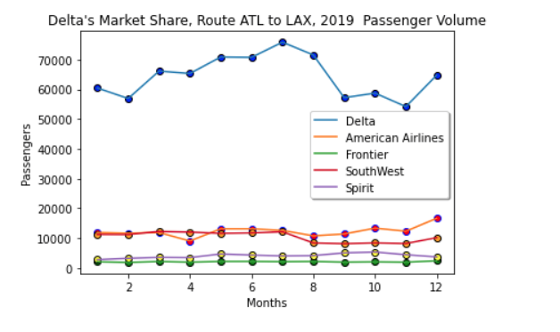
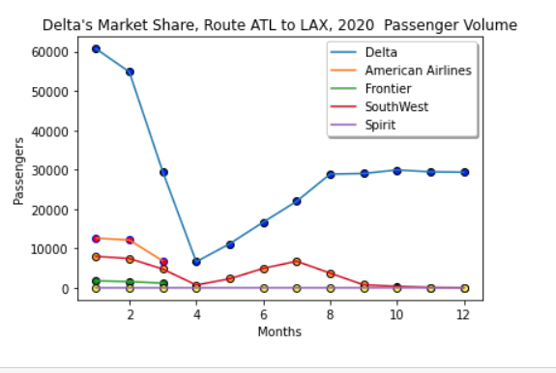
Market Position, Delta vs Competitors
Delta is normally a dominant player for this route, because Atlanta is its hub
During 2019, we show that American Airlines began to slowly increase their volume during the winter months.
This however immediately ceased during Covid when American Airlines ended this route.
During 2020 the only major airline to significantly attempt to take market share away from Delta is Southwest
Delta remains the Dominant player for this route.

Slide 9
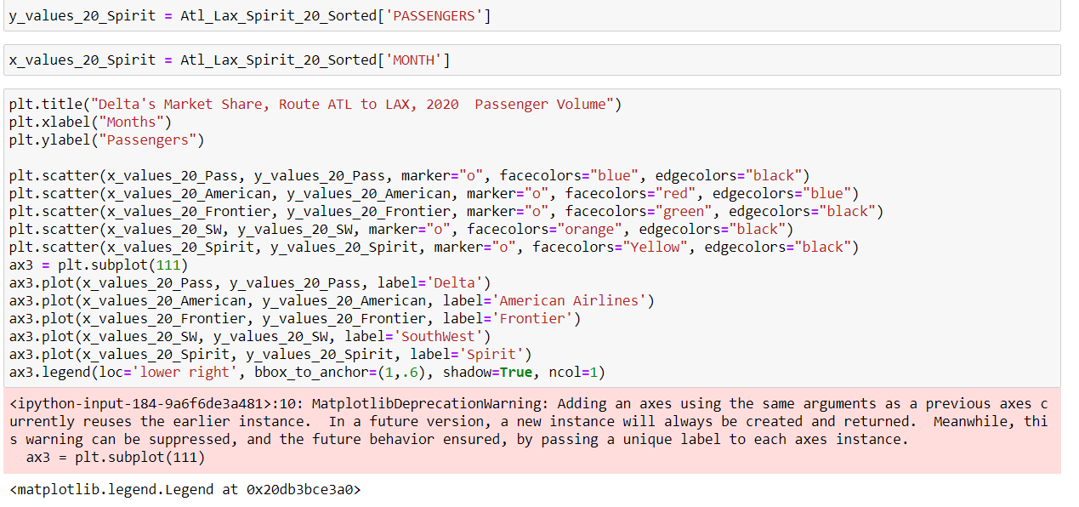
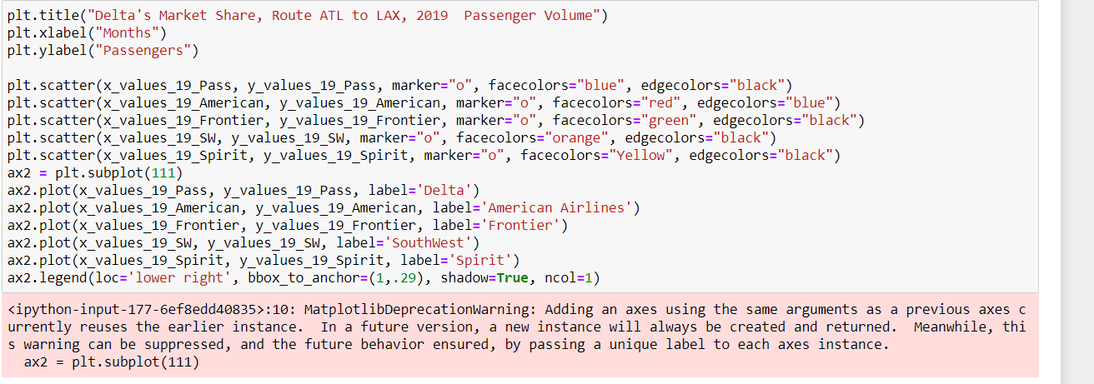
Here is the code for the previous chart: Market Position, Delta vs Competitors

Slide 10
DISCUSSION and post mortem

Slide 11
Challenges for future prediction

